Slide 1
Word Scramble App
Georgia Institute of Technology CS6300 Software Development Process Fall 2017 James Chan
Source code sharing subject to Georgia Tech Honor Code restriction. Available for private viewing upon request.

Slide 2
Overview
Developed a word scramble app as a team using software engineering practices. The team consists of four graduate students in computer science at Georgia Tech.
Personal contribution:
35% of the back-end code
65% of the front-end code
20% of the test cases
Generation of UI designs

Slide 3
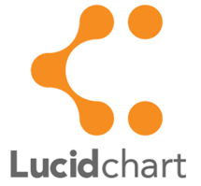

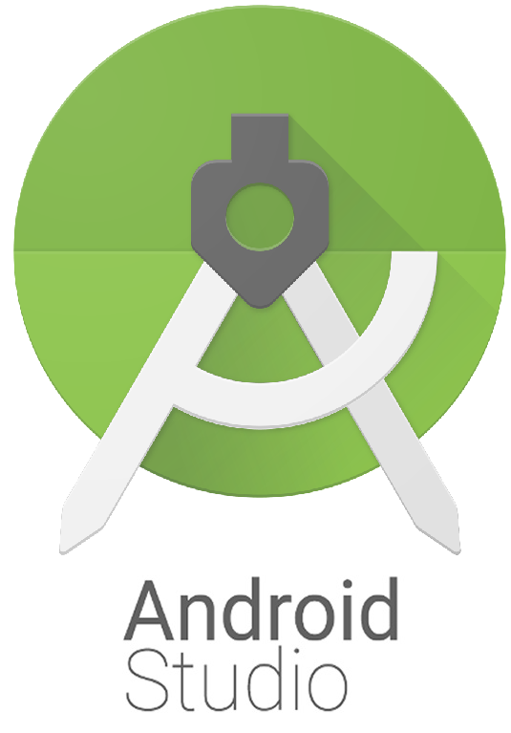
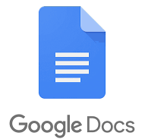


Tools Used
Google Docs – collaboration, planning, and organization.
Google Hangout – daily meeting.
Github – collaboration and version control.
Lucidchart – UML diagram generation.
Fluid UI – UI design and mockup generation.
Android Studio – development.

Slide 4
Project Milestones
Requirement
Analysis
Tools: - Google Docs - Google Hangout
Design/UML Diagram Tools: - Lucidchart - Fluid UI - Google Hangout
Implementation Tools: - Android Studio - Github - Google Hangout
Planning Tools: - Google Docs - Google Hangout
Testing Tools: - Google Hangout
Deployment

Slide 5
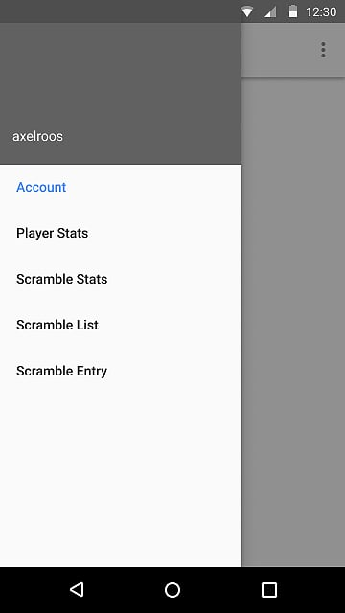
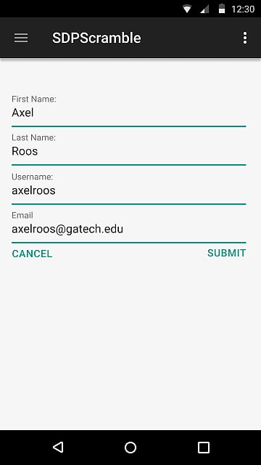
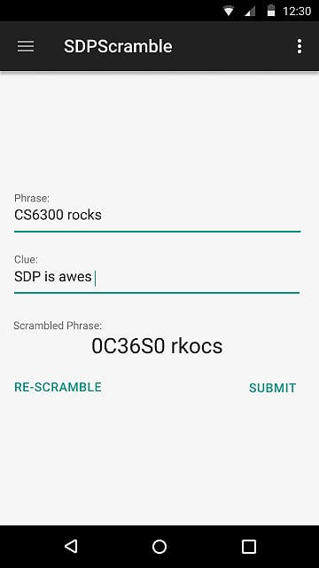
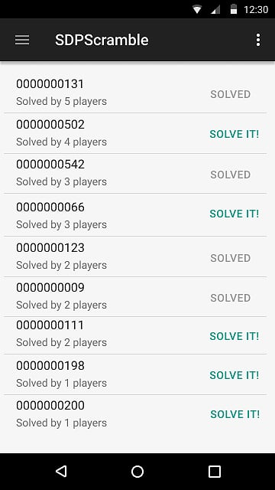
User Interface As Designed

Slide 6
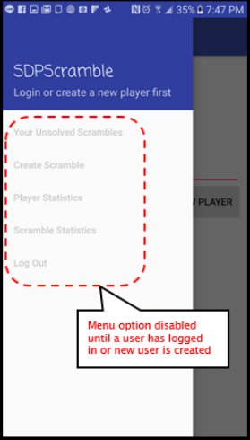
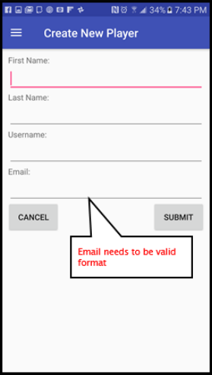
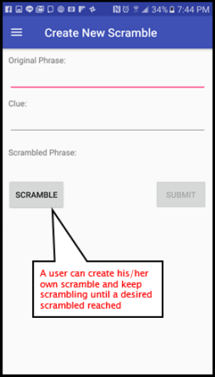
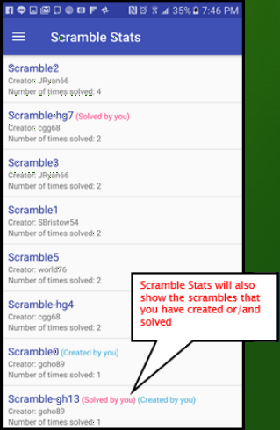
Final Deliverable

